Slide 1
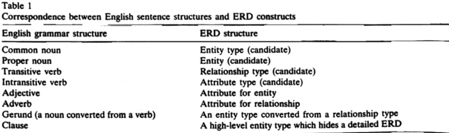
Chen’s Type Guidance

Slide 2
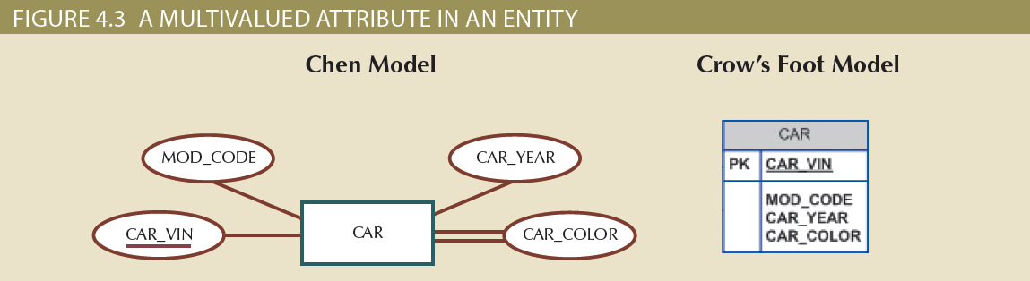
Figure 4.3 - A Multivalued Attribute in an Entity

Slide 3
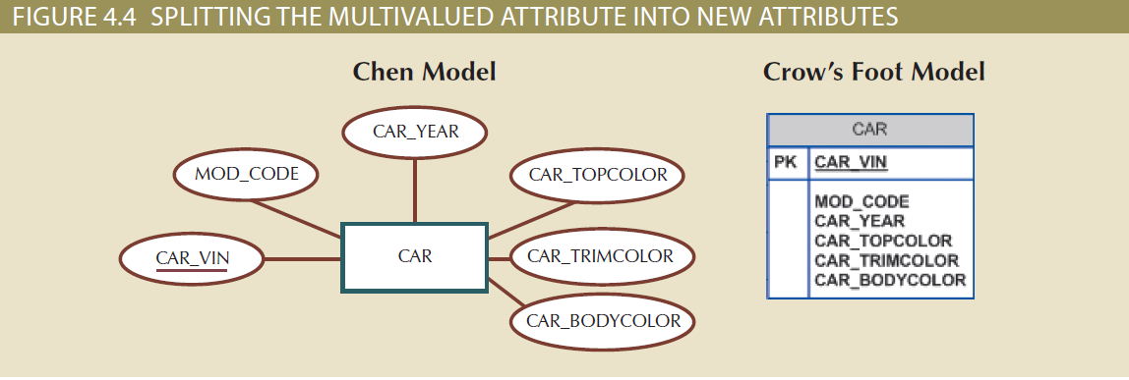
Figure 4.4 – Splitting the Multivalued Attributes into New Attributes

Slide 4
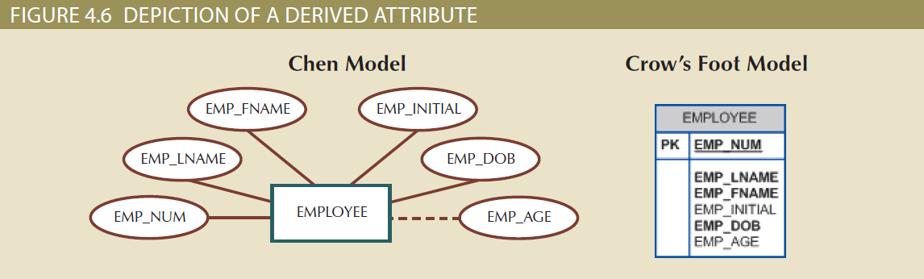
Figure 4.6 - Depiction of a Derived Attribute

Slide 5
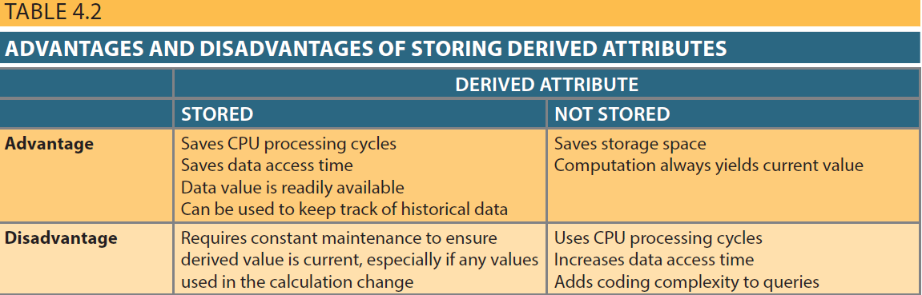
Table 4.2 - Advantages and Disadvantages of Storing Derived Attributes

Slide 6
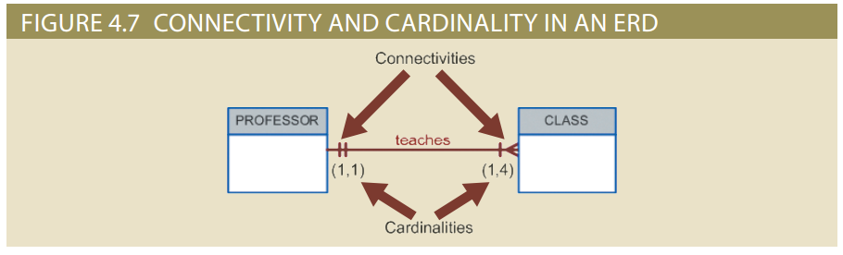
Figure 4.7 - Connectivity and Cardinality in an ERD

Slide 7
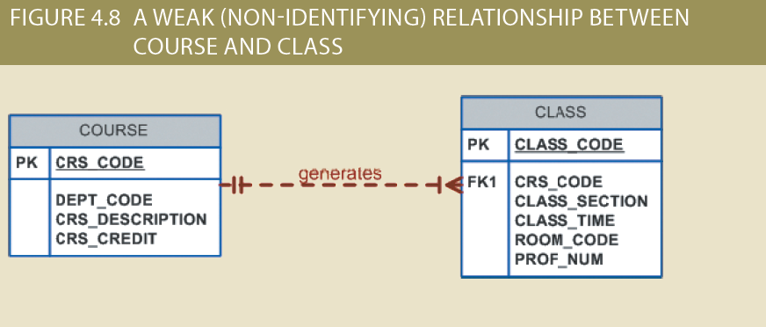
Figure 4.8 - A Weak (Non-Identifying) Relationship between COURSE and CLASS

Slide 8
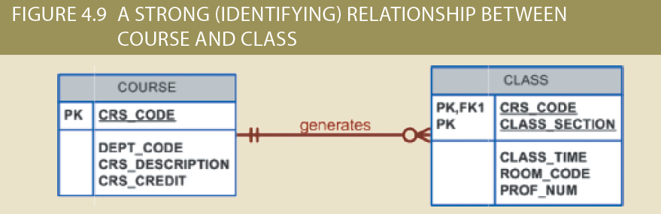
Figure 4.9 - A Strong (Identifying) Relationship between COURSE and CLASS

Slide 9
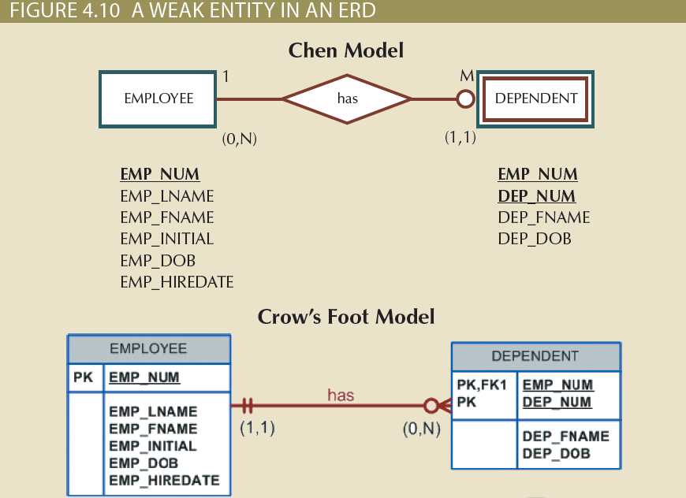
Figure 4.10 - A Weak Entity in an ERD

Slide 10
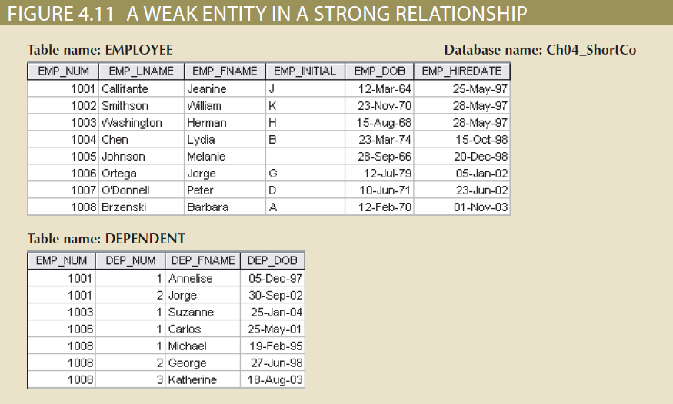
Figure 4.11 - A Weak Entity in a Strong Relationship

Slide 11
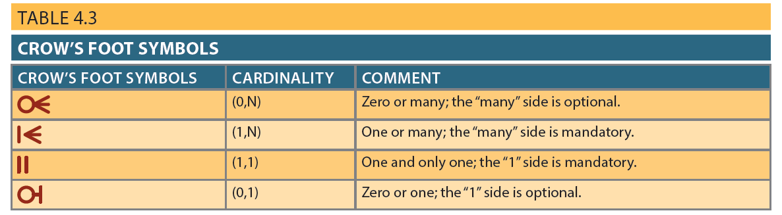
Table 4.3 - Crow’s Foot Symbols

Slide 12
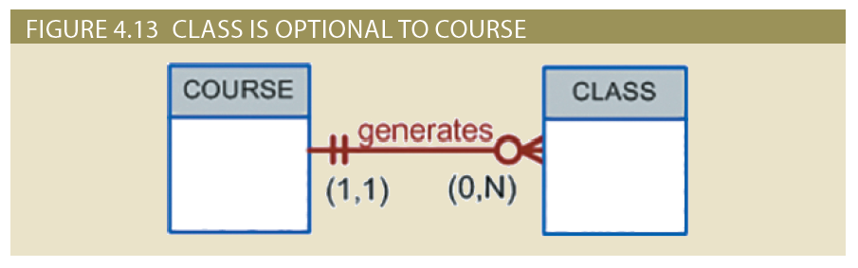
Figure 4.13 - CLASS is Optional to COURSE

Slide 13
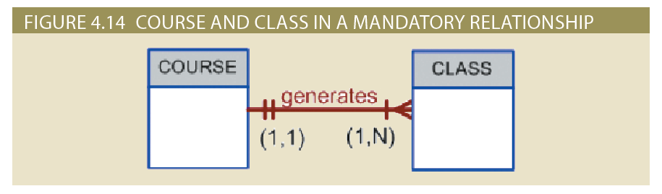
Figure 4.14 - COURSE and CLASS in a Mandatory Relationship

Slide 14
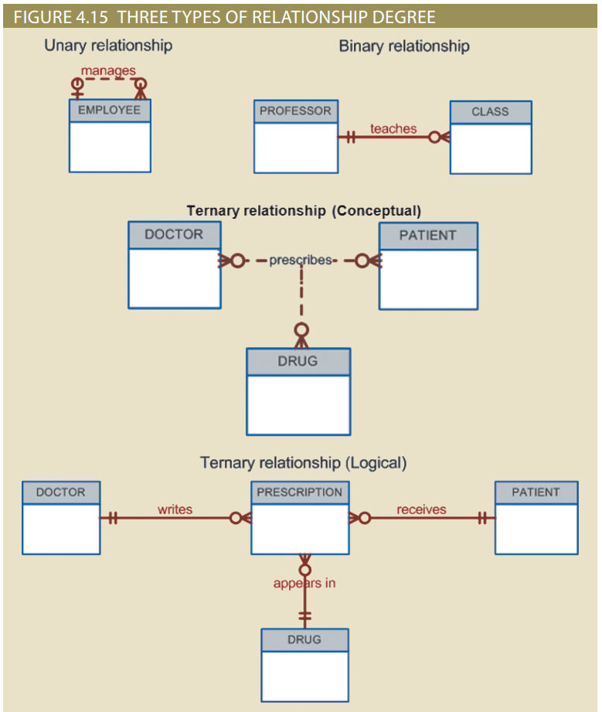
Figure 4.15 - Three Types of Relationship Degree

Slide 15
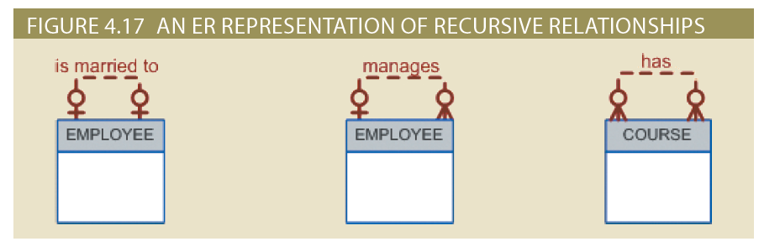
Figure 4.17 - An ER Representation of Recursive Relationships

Slide 16
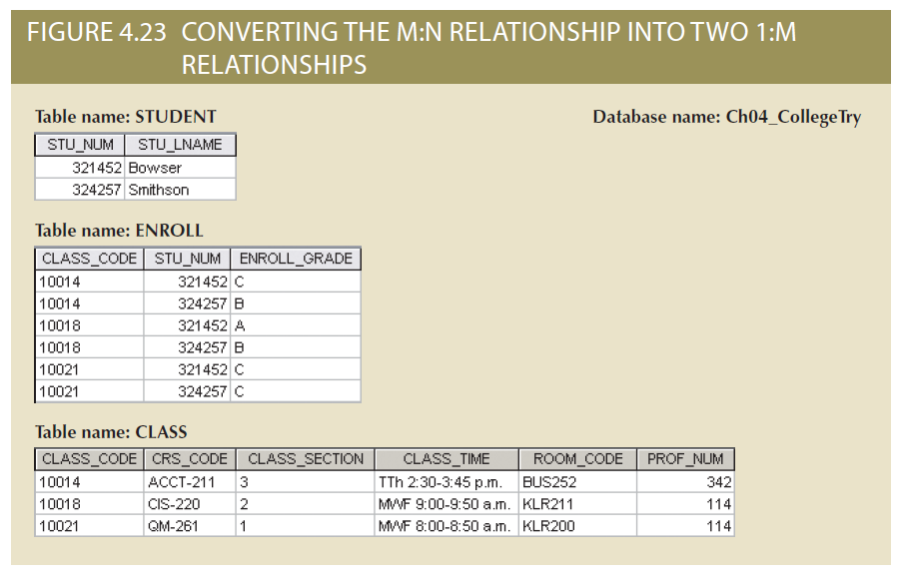
Figure 4.23 - Converting the M:N Relationship into Two 1:M Relationships

Slide 17
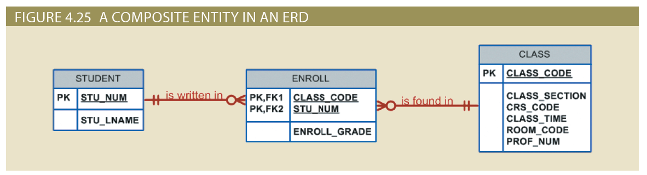
Figure 4.25 - A Composite Entity in an ERD

Slide 18
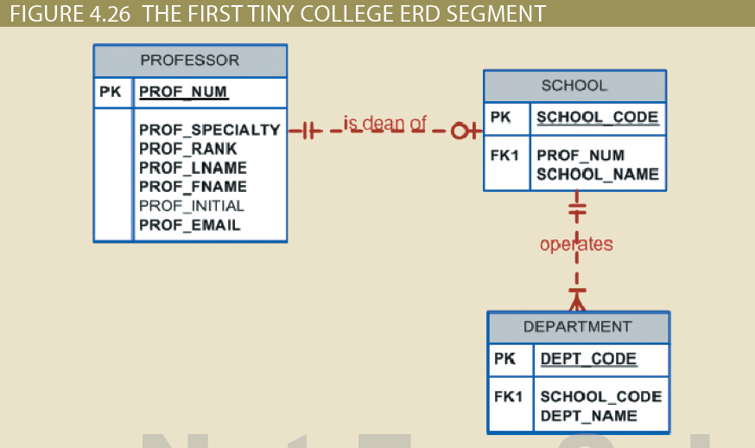
Figure 4.26 - The First Tiny College ERD Segment

Slide 19
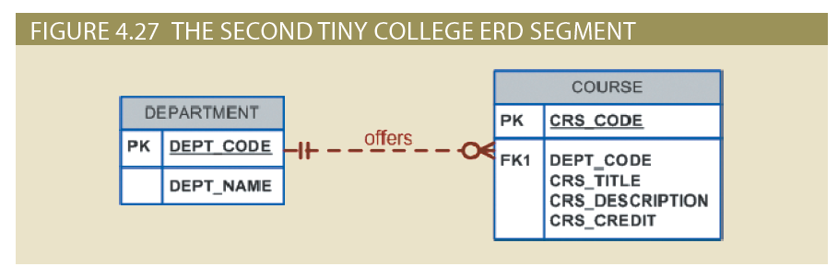
Figure 4.27 - The Second Tiny College ERD Segment

Slide 20
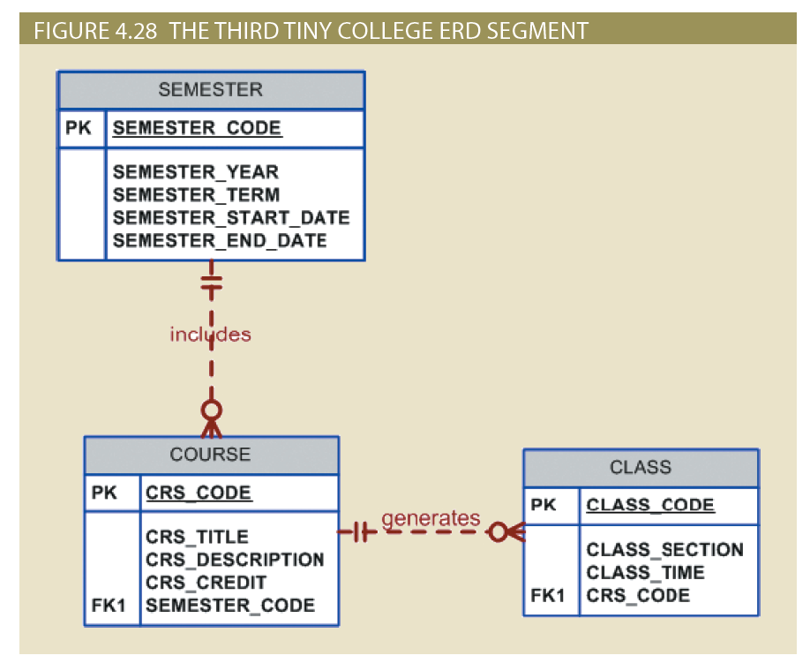
Figure 4.28 - The Third Tiny College ERD Segment

Slide 21
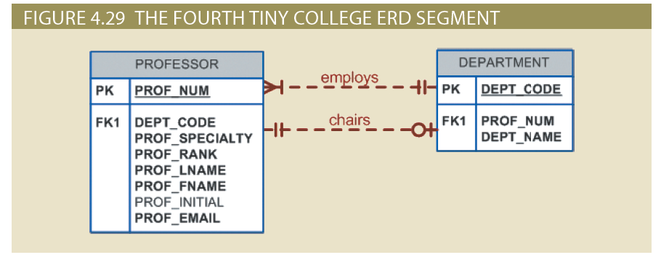
Figure 4.29 - The Fourth Tiny College ERD Segment

Slide 22
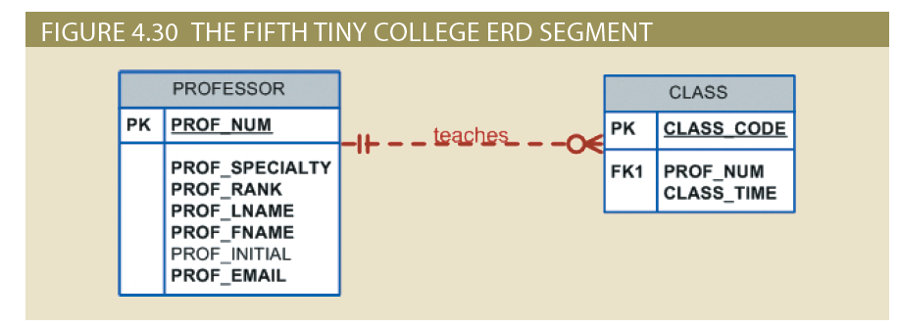
Figure 4.30 - The Fifth Tiny College ERD Segment

Slide 23
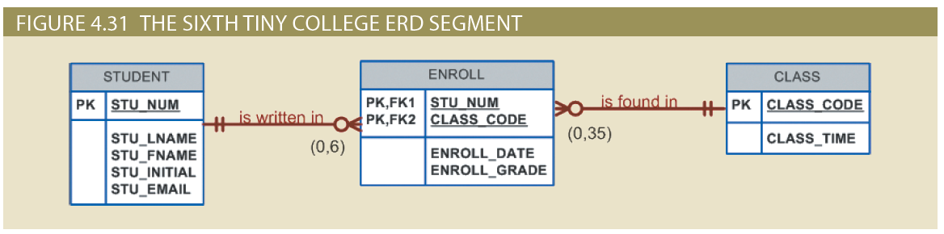
Figure 4.31 - The Sixth Tiny College ERD Segment

Slide 24
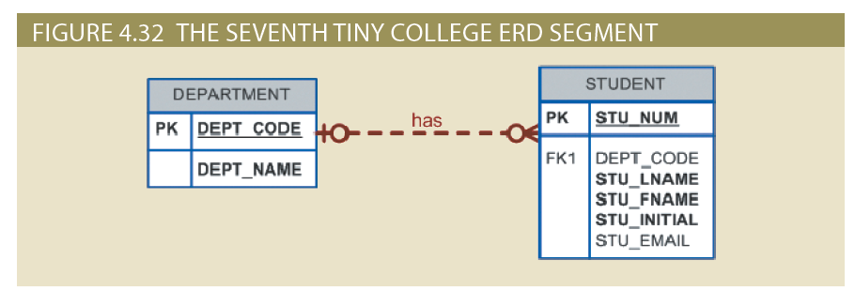
Figure 4.32 - The Seventh Tiny College ERD Segment

Slide 25
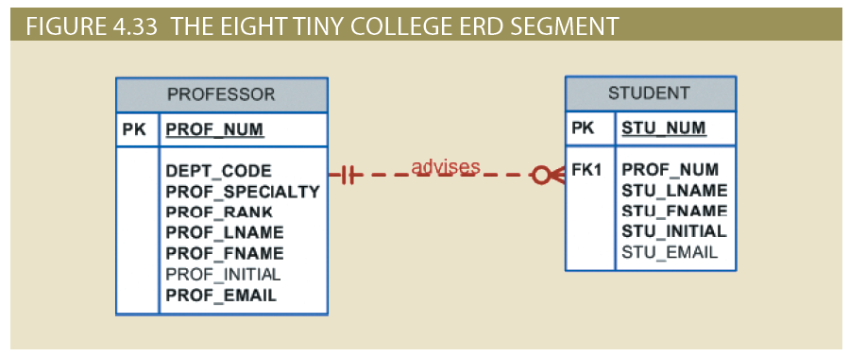
Figure 4.33 - The Eighth Tiny College ERD Segment

Slide 26
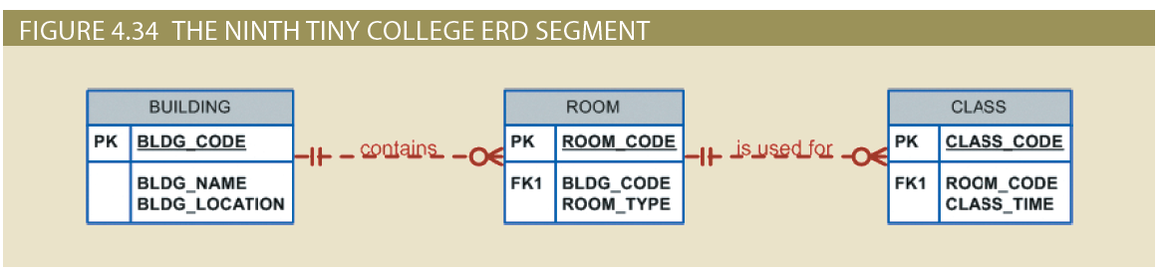
Figure 4.34 - The Ninth Tiny College ERD Segment

Slide 27
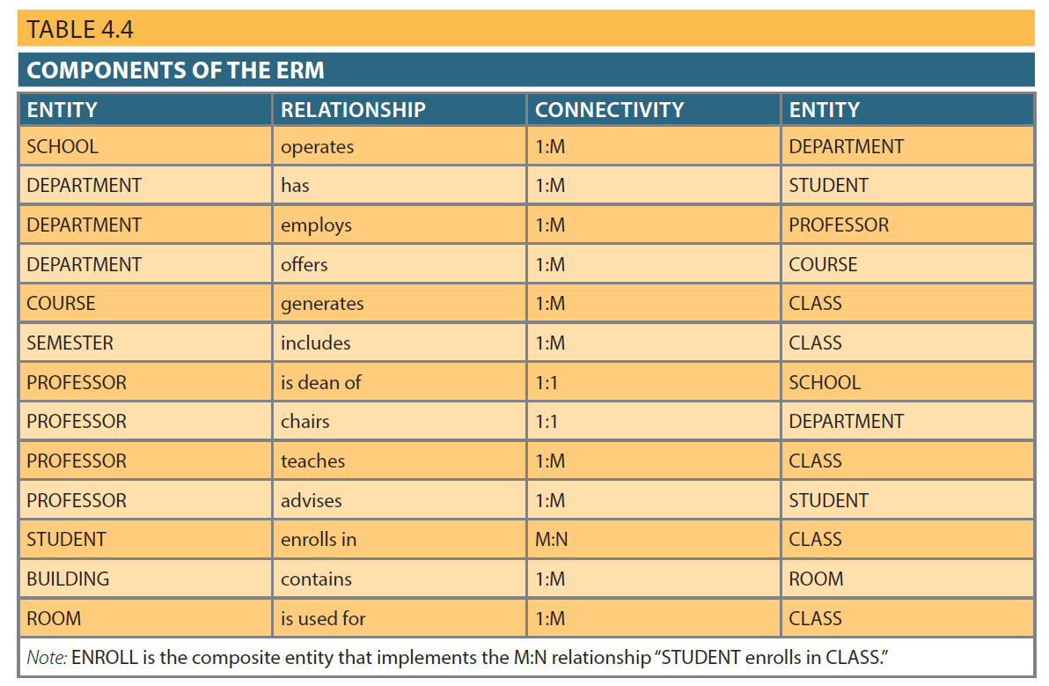
Table 4.4 - Components of the ERM

Slide 28
Database Design Challenges: Conflicting Goals
Database design must conform to design standards
Need for high processing speed may limit the number and complexity of logically desirable relationships
Need for maximum information generation may lead to loss of clean design structures and high transaction speed

Slide 29
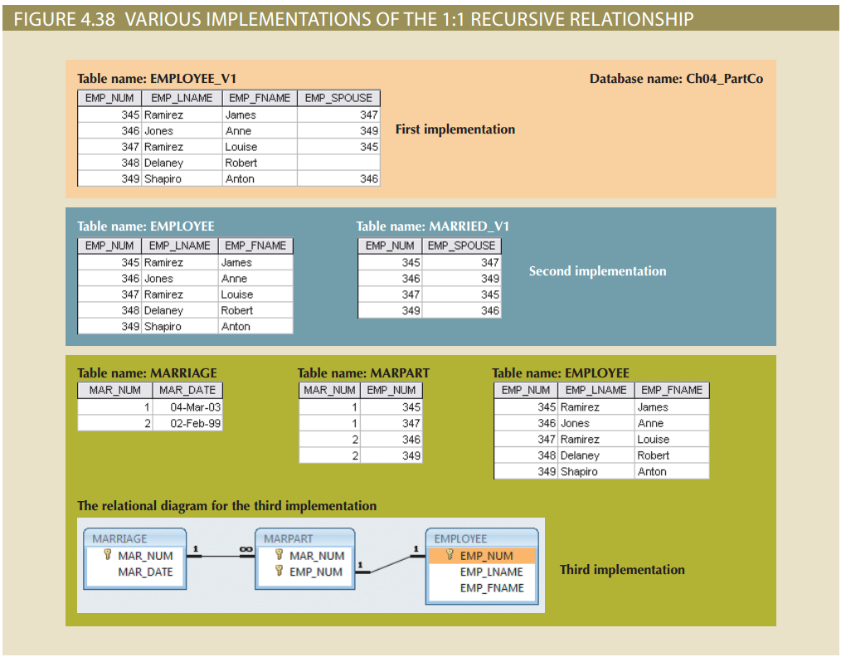
Figure 4.38 - Various Implementations of the 1:1 Recursive Relationship

